Slide 1



UNIT 4:
So much to do, so little time
My hobby

Slide 2
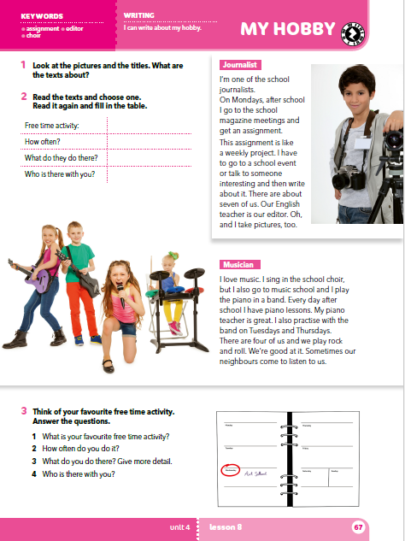
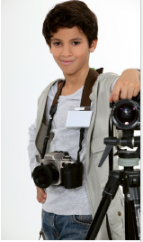
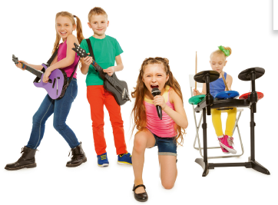
Look at the pictures and asnwer the questions.
What do they look like?
What do you think they’re like?
What are their hobbies?
What do you think their hobbies are like?
What do they do?

Slide 3
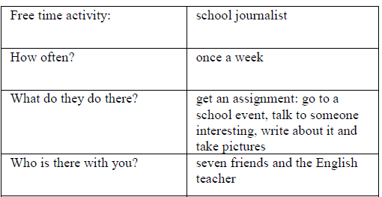
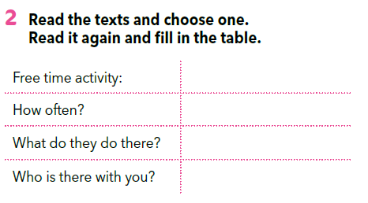
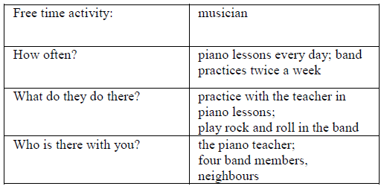
Match the sentence with the person who says it.
https://www.bookwidgets.com/play/t:dj4Z8macMXXZwZ3DWWUdFJNA+1wyoPT88wOflAEETb9LRUs0Uzk=
Slobodna aktivnost:
TRANSLATE
assignment =
editor =
choir =
zadatak
urednik
zbor

Slide 4
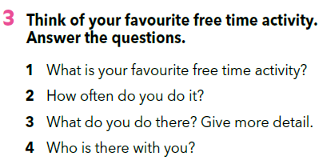
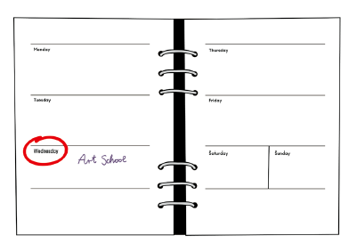

Slide 5
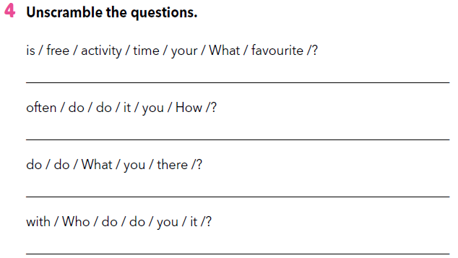
What is your favourite free time activity?
How often do you do it?
What do you do there?
Who do you do it with?

Slide 6
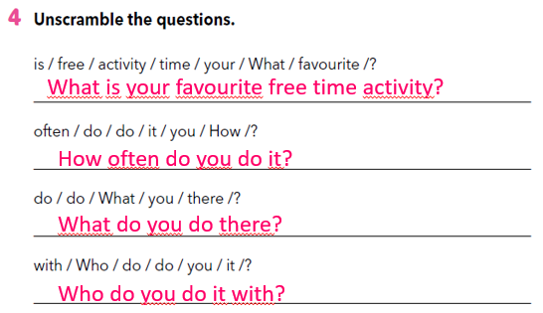
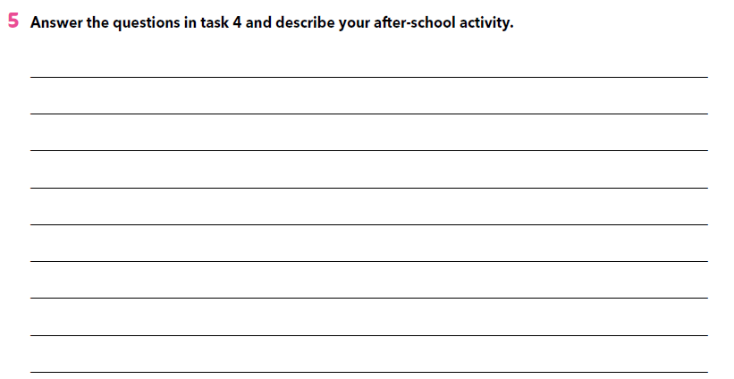

Slide 7

LEARN MORE.
https://www.e-sfera.hr/dodatni-digitalni-sadrzaji/386e6f5f-c7ce-4f87-a861-54a77ff7172f/
Hobbies of celebrities

